Slide 1

Entrepreneurism in India
Submitted to: Ian Garrett
Submitted By: Yogesh Sharma
Student #220139598

Slide 2
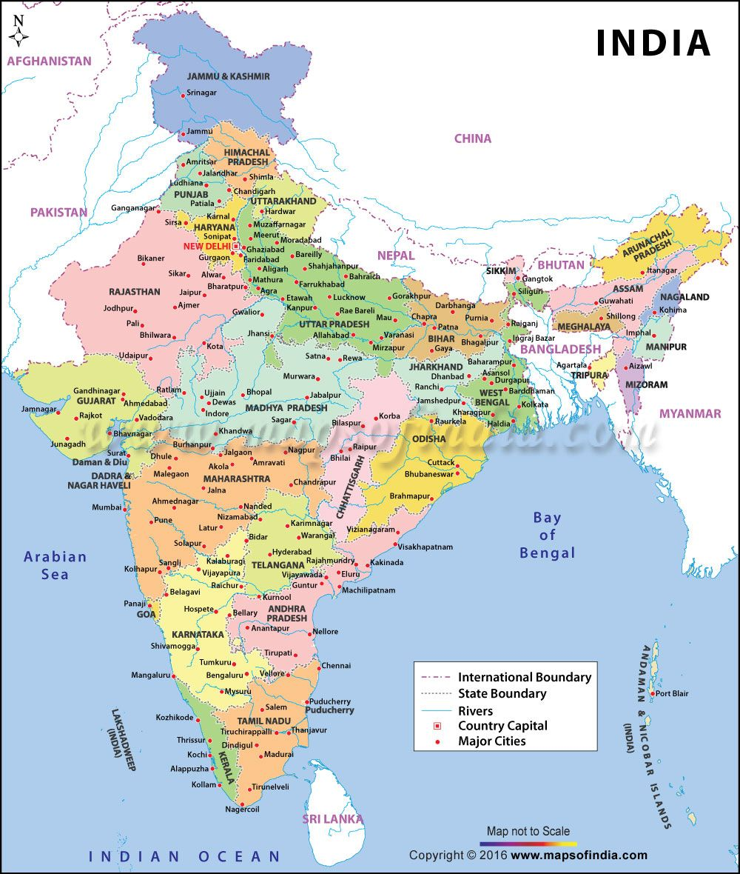
Introduction
The purpose of this presentation is to do a case about factors which are promoting/ hindering entrepreneurism in India, which is still a developing country.
This presentation will cover two factors. First, social factors and economic factors. How economic and social factors impact entrepreneurism in India.

Slide 3
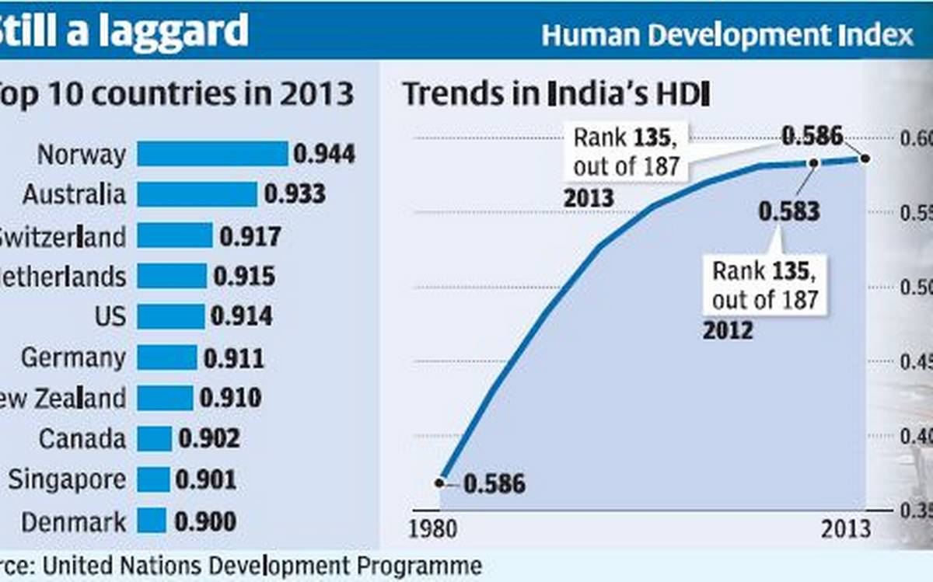
Human Development Index (HDI)
India's Global Standing
129 / 189 countries
India is ranked 129th globally in terms of Human Development.
What is HDI?
HDI is a metric developed by the United Nations to measure the growth and well-being of citizens within a country.
Current HDI Value
0.647 – 0.660
A measure of life expectancy, education, and per capita income.

Slide 4
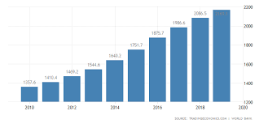
GDP (Gross Domestic Product)
Global Ranking
145 / 190+ countries
India's rank in terms of per capita GDP (in $US).
Pandemic Impact (2020)
-29% GDP Fall
One of the most significant declines globally.
Per Capita GDP (2018-2019)
$2,104.10 USD
Equivalent to approximately ₹105,688 INR.

Slide 5
Economic Factors Affecting Businesses in India
Rising Income
Incomes of Indian families have been rising from previous years which makes it easier for them to afford luxuries and other items.
GDP & Cost of Living
₹105,668
GDP per capita
The cost of living in India is much lower compared to the USA because items are sold at lower rates, leading to higher profits for businesses.
Startup Investment
Investing in small startups is much cheaper in India as the cost of land is also lower compared to developed countries like USA, Great Britain, Australia, and Canada.

Slide 6
Some more positive impacts of Economy on Businesses
Demonetization
GST(Goods Services Tax)
Demonetization took place in India in year 2016 during August to October months banning old Rs.1000 and Rs 500 notes.
This demonetization has led to positive impacts on Indian economy and helped in businesses and entrepreneurs to grow.
Government of India introduced GST in 2017 in July.
The biggest benefit of GST is an elimination of multiple indirect taxes. All taxes that currently exist will not be in picture. This means current taxes like excise, octroi, sales tax, CENVAT, Service tax, turnover tax etc will not be applicable and all that will fall under common tax called as GST.

Slide 7

Negative Impacts of Economic factors on Indian Entrepreneurism
Centralization of Economic power in hands of big industrialists is one of the most important factor impacting growth of smaller businesses and entrepreneurs.
Red -Tapism due to rules and regulations and lack of incentives and support from government does not lead to growth of Indian entrepreneurs who are new and freshly started

Slide 8
Positive Social factors for entrepreneurism in India
Education: - In terms of education and knowledge, people in India have very much experience and certified degrees in specific fields which makes them good for entrepreneurship.
Sundar Pichai (CEO of Google) is a graduate from IIT(Indian Institute of Technology) Roorkee and has spoken about learning environment in IIT in his interviews.
Also India is a great place to prosper social relations as Indians place great value on relationships.
These relationships are important for successful businesses and their growth.

Slide 9
Social factors hindering entrepreneurism in India
Traditional Society and superstitions still considers some jobs to be inferiors and act as a barrier in business growth and prosperity.
Cultural values in India has not laid much emphasis on economic growth and businesses. People still believe in “Simple living and high thinking”, so many entrepreneurial ideas are affected like branded clothes, fancy dinners with family, going on vacations, watching movies at cinemas, etc.

Slide 10

Major Social factor affecting entrepreneurial growth
Society considers women weak
Women are often portrayed as weak in Indian society because it is a male dominating society.
Due to lack of women participation, there is very less chance of entrepreneurial growth.

Slide 11
Famous Entrepreneurs impacting country
Mukesh Ambani
Azim Premji
Akhila Srinivasan
Kumar Mangalam Birla

